Slide 1

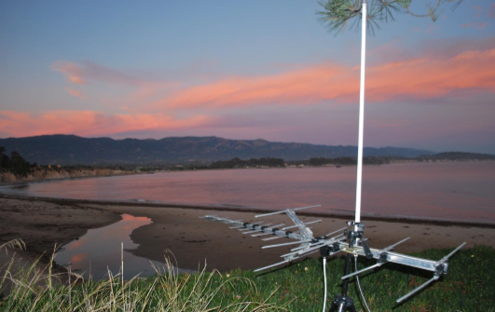

Slide 2


The WOAN is back !
2 x 25 MHz of 800 MHz band (band 20).
2 x 20 MHz of 2600 MHz FDD (Frequency Division Duplex) band (Band 7).
25 MHz of 2600 MHz TDD (Time Division Duplex) band (Band 38).

Slide 3


Slide 4


Slide 5
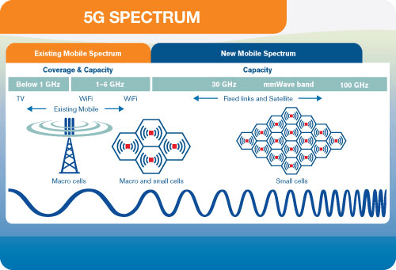

Slide 6
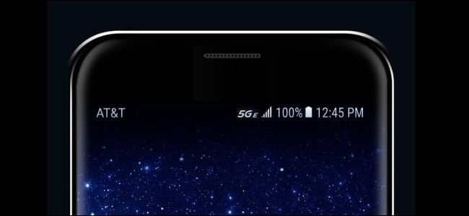


Slide 7
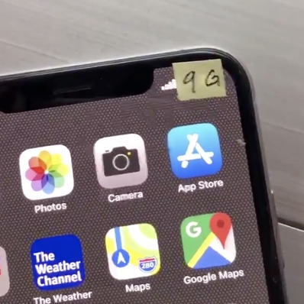

Slide 8
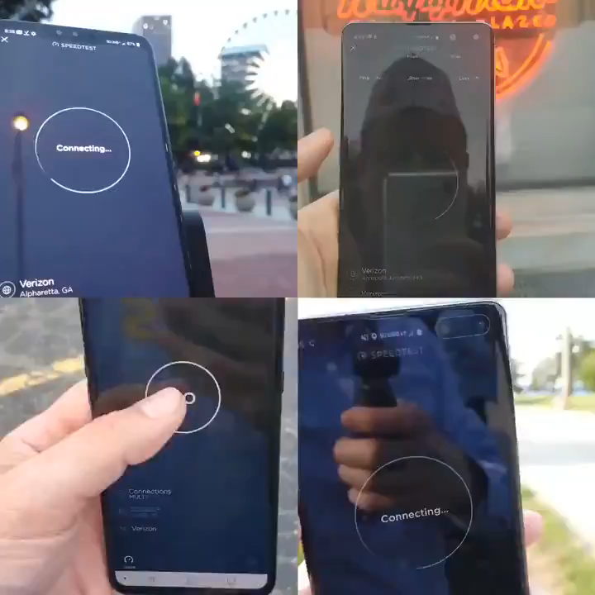

Slide 9
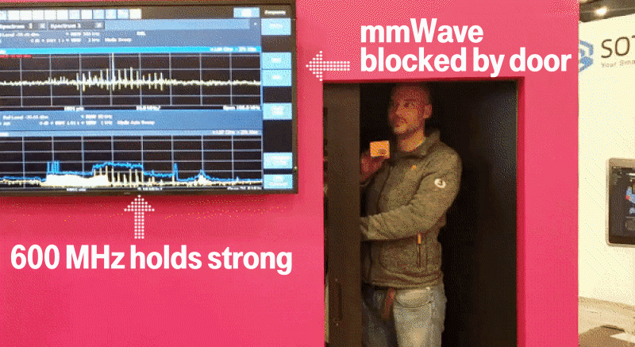
5g problems

Slide 10


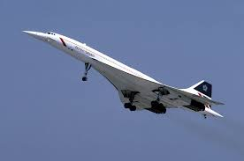
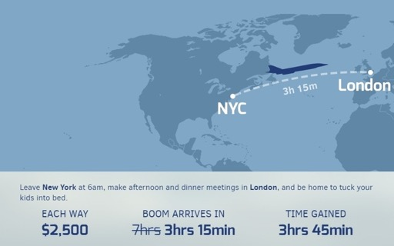


The Need for Speed
1G
3G
5G
2G
4G
Faster 3G

Slide 11


Slide 12



Slide 14
5g problems

Slide 15
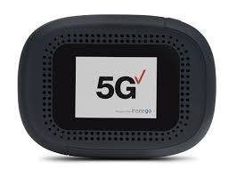
Verizons new home 5G modem
28ghz & 39ghz
Business customers Unlimited 5G $45
FUP 35GB then 200kbps

Slide 16
Verizons new home 5G modem
28ghz & 39ghz
Home customers FUP 50GB with speeds throttling to 3mbps .

Slide 17

Verizons new home 5G modem
28ghz & 39ghz
Home customers FUP 50GB with speeds throttling to 3mbps .

Slide 18
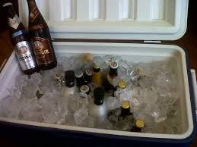
Verizons new home 5G modem
28ghz & 39ghz
Home customers FUP 50GB with speeds throttling to 3mbps .

Slide 19


Slide 20




Slide 21
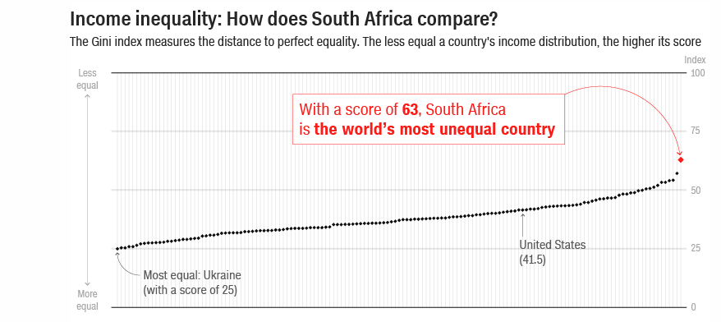

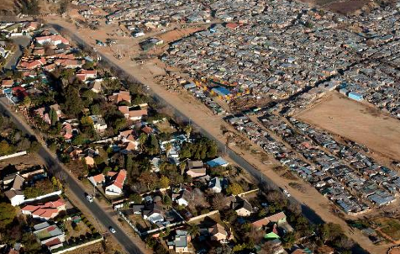
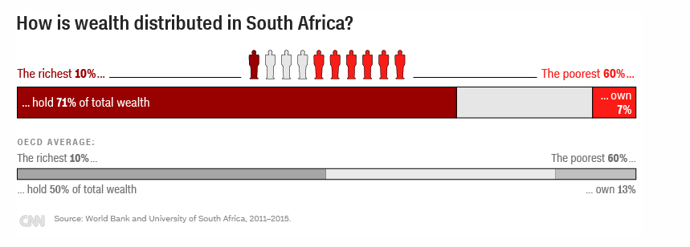
10 May 2019

Slide 22
South Africa Connected households
7.5 million lower income homes are paying up to 80X more for Internet access than high income homes
Smart phone Internet access.
Data Cost up to R500 per GB
Only 10% of SA homes have fixed affordable Internet.
Data Cost < R10 per GB

Slide 23
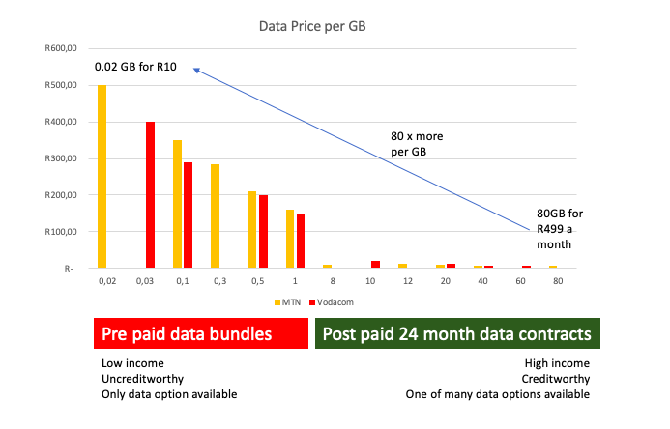
Cost of Data contracts
R500 per GB
R6.25 per GB

Slide 24
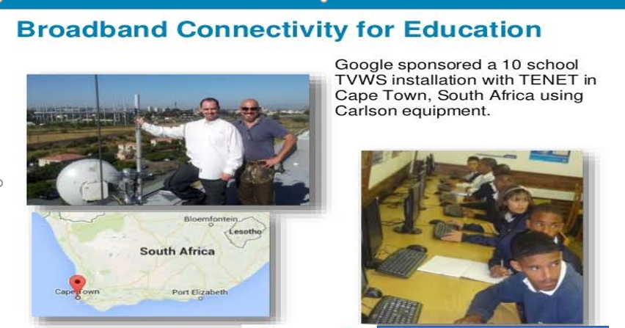


Slide 25
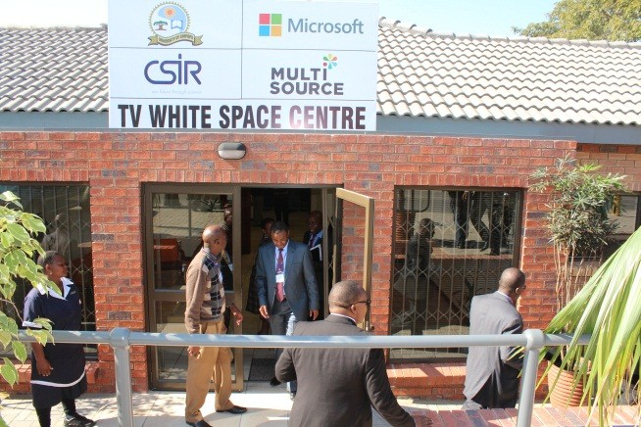

Slide 26
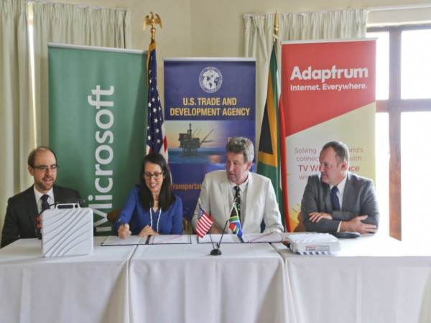

Slide 27






USTDA have granted funding for the South African TV White Space project with the below partners .
Wapa will engage in field trials with equipment from Adaptrum and manage the road map and deliverables and goals of the project . The 1st step into bridging the digital divide in SA !

Slide 28
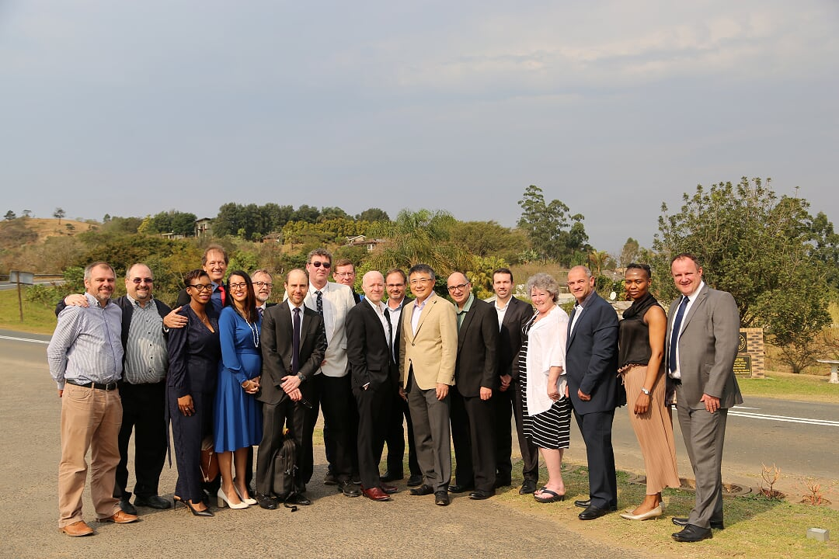

Slide 29
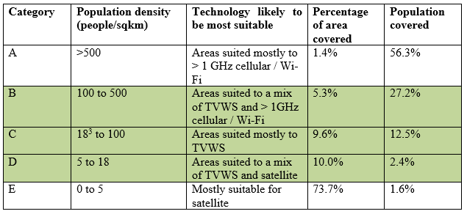
470 – 694 MHz (TV White Space)
Matching technology to population density in South Africa

Slide 30
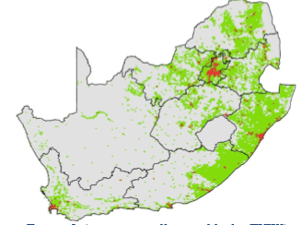
Areas in green suitable for TVWS
‘Sweet spots’

Slide 31
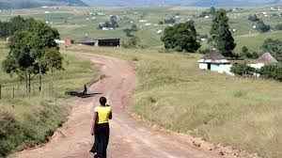
Low population density rural

Slide 32
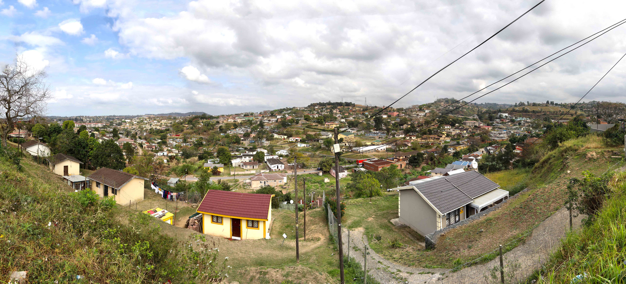
Semi rural

Slide 33
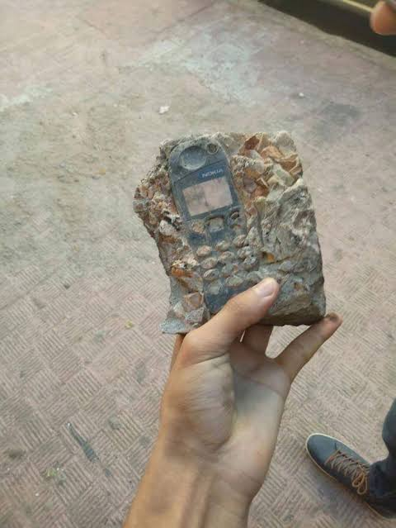
A fossilized 3310

Slide 34
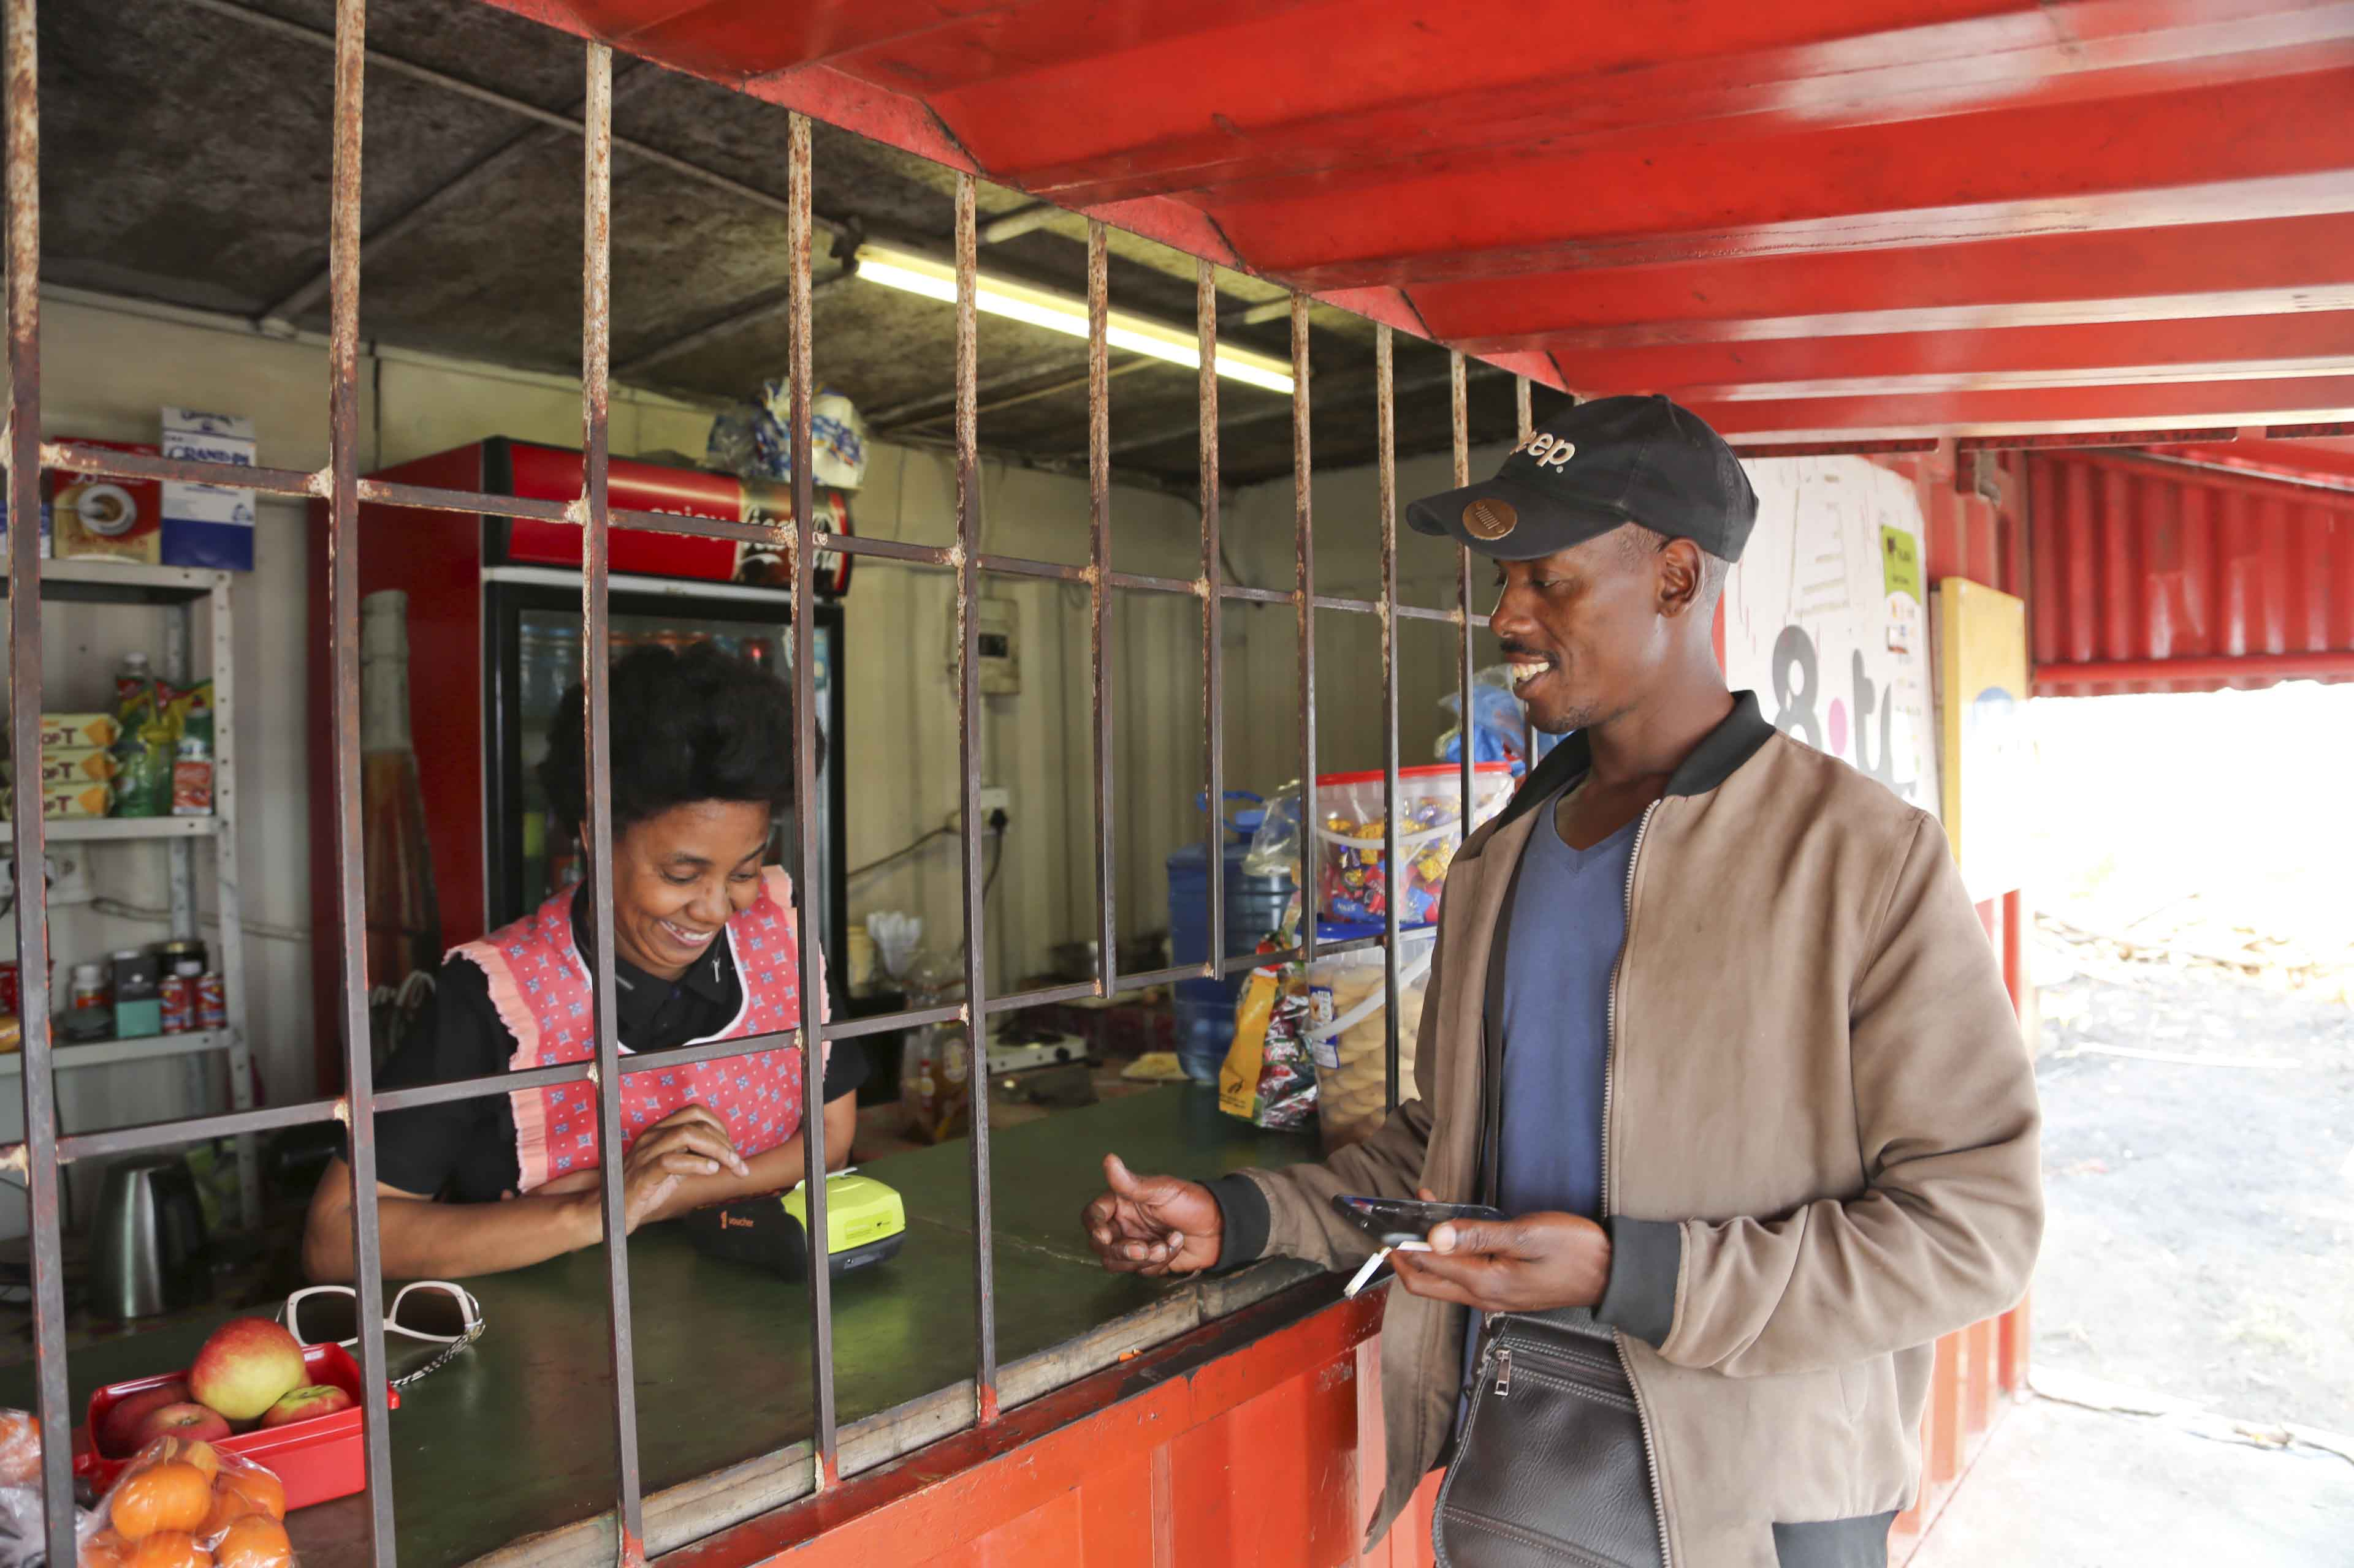

Slide 35
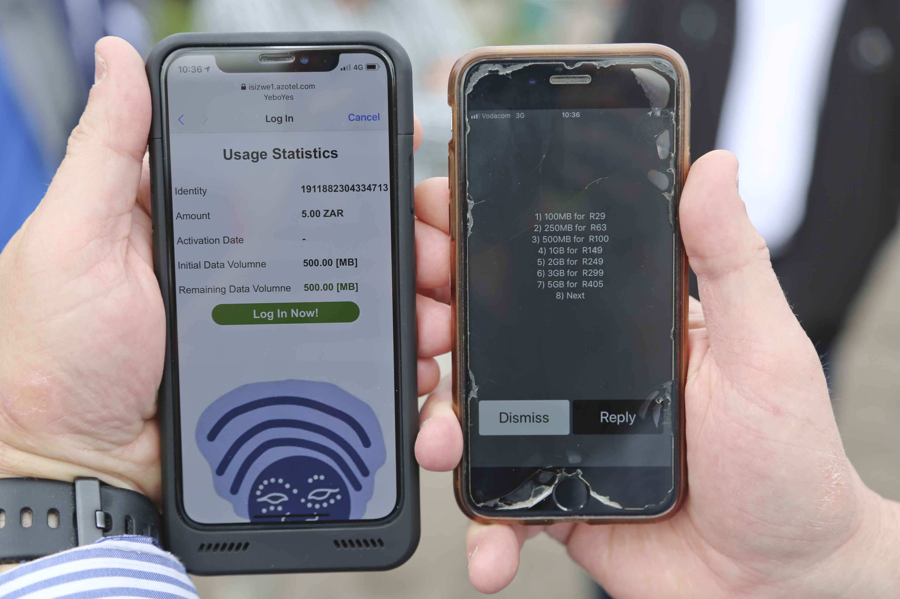
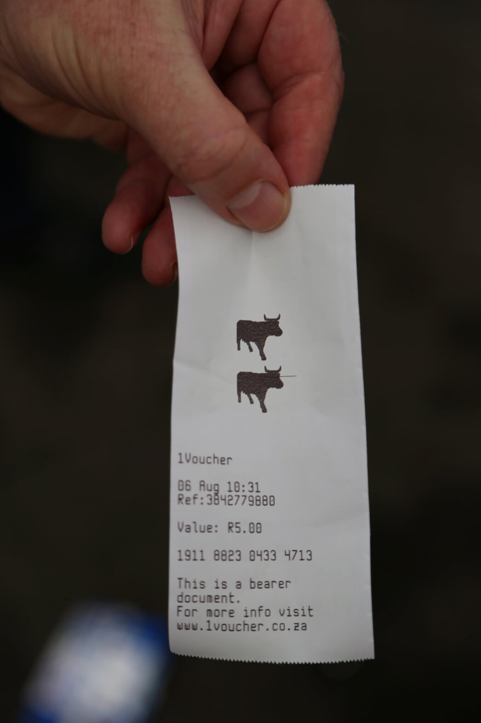
Areas in green suitable for TVWS
‘Sweet spots’

Slide 36
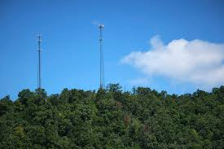
Wisp’s will be the real heroes in ‘Bridging the digital divide with dynamic spectrum’

Slide 37

Follow me @

